Slide 1
New layouts, data types, and architecture for GRNsight 3: a web application for visualizing gene regulatory networks
Mihir Samdarshi
Department of Biology
Loyola Marymount University
March 23, 2019
LMU Undergraduate Research Symposium

Slide 2
Outline
Gene regulatory networks (GRNs) consist of genes, transcription factors, and the regulatory relationships between them.
GRNsight is an open source web application and service for visualizing models of gene regulatory networks.
GRNsight has evolved significantly since version 1.0, adding useful new features
In GRNsight version 3.0, features were added to better facilitate graph comparison and sharing.
In GRNsight version 3.0, a complete refactor was done on the codebase, transitioning it to a strict Model-View-Controller paradigm.

Slide 3
Outline
Gene regulatory networks (GRNs) consist of genes, transcription factors, and the regulatory relationships between them.
GRNsight is an open source web application and service for visualizing models of gene regulatory networks.
GRNsight has evolved significantly since version 1.0, adding useful new features
In GRNsight version 3.0, features were added to better facilitate graph comparison and sharing.
In GRNsight version 3.0, a complete refactor was done on the codebase, transitioning it to a strict Model-View-Controller paradigm.

Slide 4
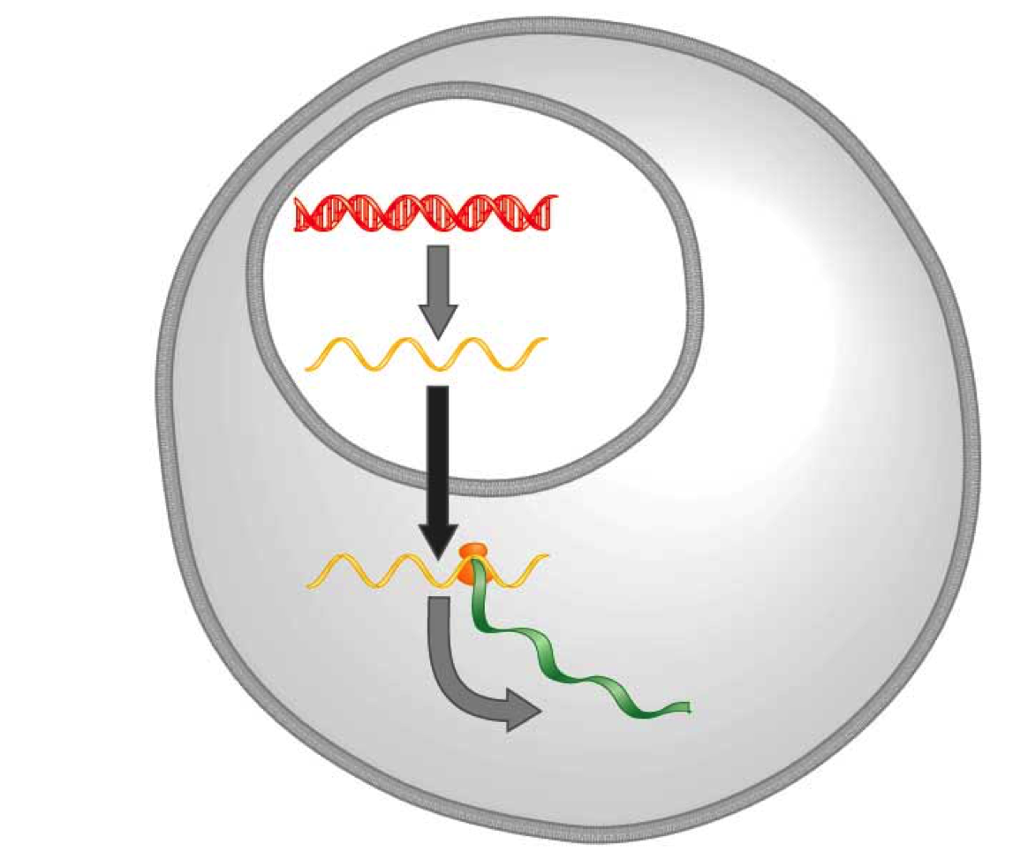
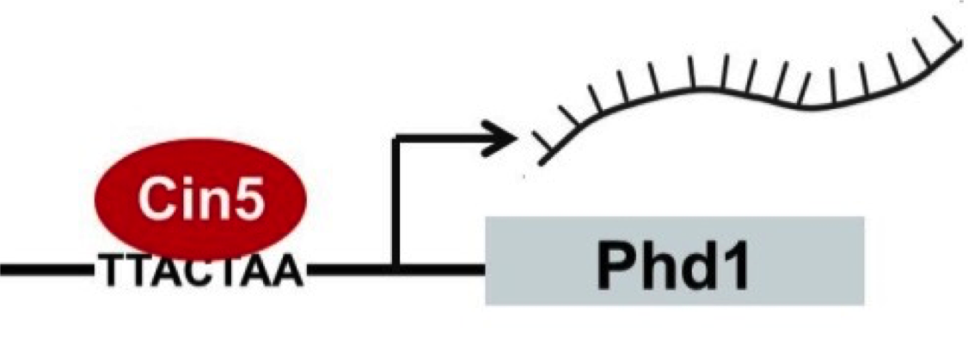
A gene regulatory network (GRN) controls the level of expression of genes and proteins
Transcription factors activate or repress expression.
To understand GRNs we want to quantify the weight values of these regulatory relationships
DNA
Transcription
mRNA
Translation
Protein
Gene regulatory process

Slide 5
GRNmap models the dynamics of GRNs to estimate weight parameters (w)
Magnitude of weights represent the influence of transcription factor on its target gene
Positive weights = activation of gene expression.
Negative weights = repression of gene expression.
GRNmap differential equation

Slide 6
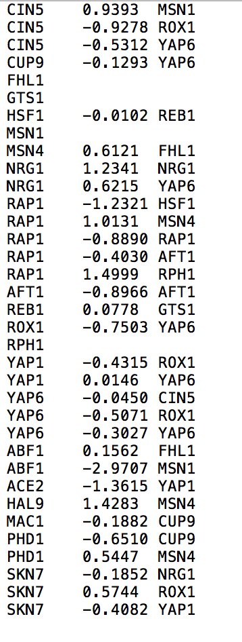
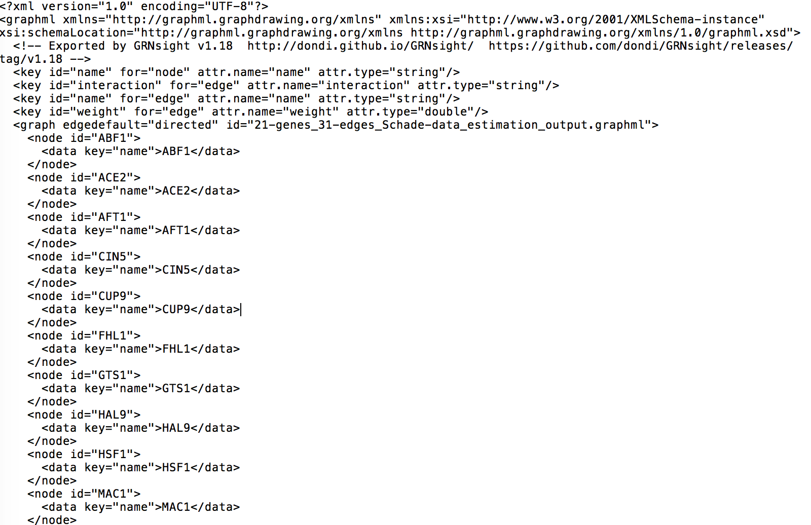
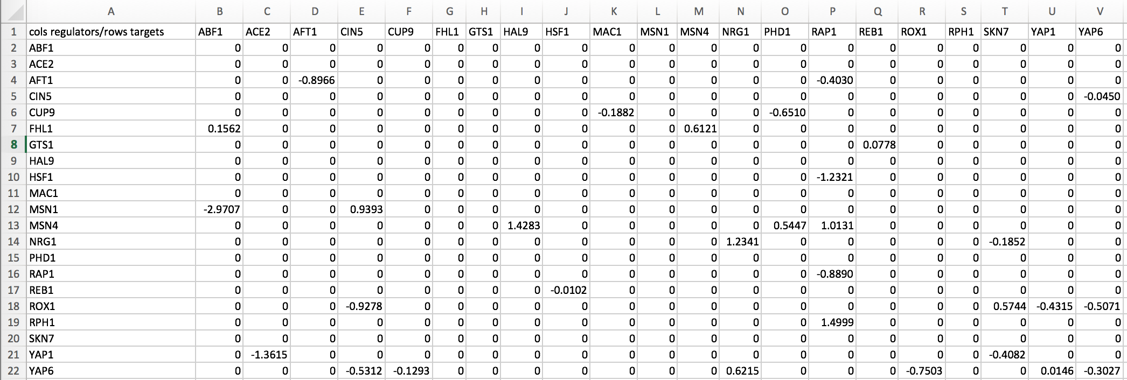
A gene regulatory network (GRN) controls the level of expression of genes and proteins
.xlsx
.graphml
.sif
21 gene, 31 edge weighted network output from GRNmap

Slide 7
Outline
Gene regulatory networks (GRNs) consist of genes, transcription factors, and the regulatory relationships between them.
GRNsight is an open source web application and service for visualizing models of gene regulatory networks.
GRNsight has evolved significantly since version 1.0, adding useful new features
In GRNsight version 3.0, features were added to better facilitate graph comparison and sharing.
In GRNsight version 3.0, a complete refactor was done on the codebase, transitioning it to a strict Model-View-Controller paradigm.

Slide 8
Outline
Gene regulatory networks (GRNs) consist of genes, transcription factors, and the regulatory relationships between them.
GRNsight is an open source web application and service for visualizing models of gene regulatory networks.
GRNsight has evolved significantly since version 1.0, adding useful new features
In GRNsight version 3.0, features were added to better facilitate graph comparison and sharing.
In GRNsight version 3.0, a complete refactor was done on the codebase, transitioning it to a strict Model-View-Controller paradigm.

Slide 9
GRNsight receives an input of data in these formats
.xlsx
.graphml
.sif
21 gene, 31 edge weighted network output from GRNmap

Slide 10
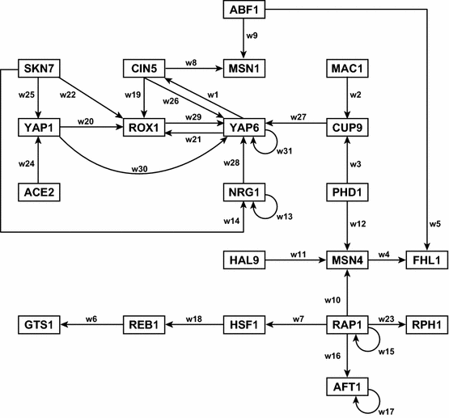
Before GRNsight, graphs would be manually plotted using Adobe Illustrator
Dahlquist et al. (2015) Bulletin of Mathematical Biology 77: 1457.

Slide 11
GRNsight fills a niche in bioinformatics visualization software
Cytoscape and Gephi | GRNsight
Optimized for large-scale graphs. | Optimized for small- to medium- scale graphs.
Must be installed. | Exists as a web application.
Several complex features in addition to visualization. | Easy to use, and easily interpretable visualizations.

Slide 12
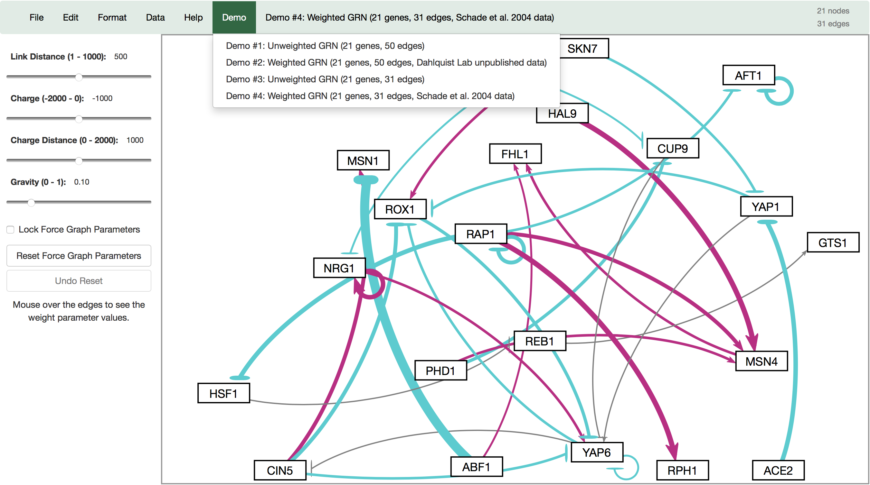
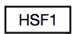
GRNsight automatically produces visualizations of weighted networks from adjacency matrix inputs
Key:
gene
activation
repression
weak influence
Screenshot of GRNsight v1, released Aug 2016

Slide 13
Outline
Gene regulatory networks (GRNs) consist of genes, transcription factors, and the regulatory relationships between them.
GRNsight is an open source web application and service for visualizing models of gene regulatory networks.
GRNsight has evolved significantly since version 1.0, adding useful new features
In GRNsight version 3.0, features were added to better facilitate graph comparison and sharing.
In GRNsight version 3.0, a complete refactor was done on the codebase, transitioning it to a strict Model-View-Controller paradigm.

Slide 14
Outline
Gene regulatory networks (GRNs) consist of genes, transcription factors, and the regulatory relationships between them.
GRNsight is an open source web application and service for visualizing models of gene regulatory networks.
GRNsight has evolved significantly since version 1.0, adding useful new features
In GRNsight version 3.0, features were added to better facilitate graph comparison and sharing.
In GRNsight version 3.0, a complete refactor was done on the codebase, transitioning it to a strict Model-View-Controller paradigm.

Slide 15
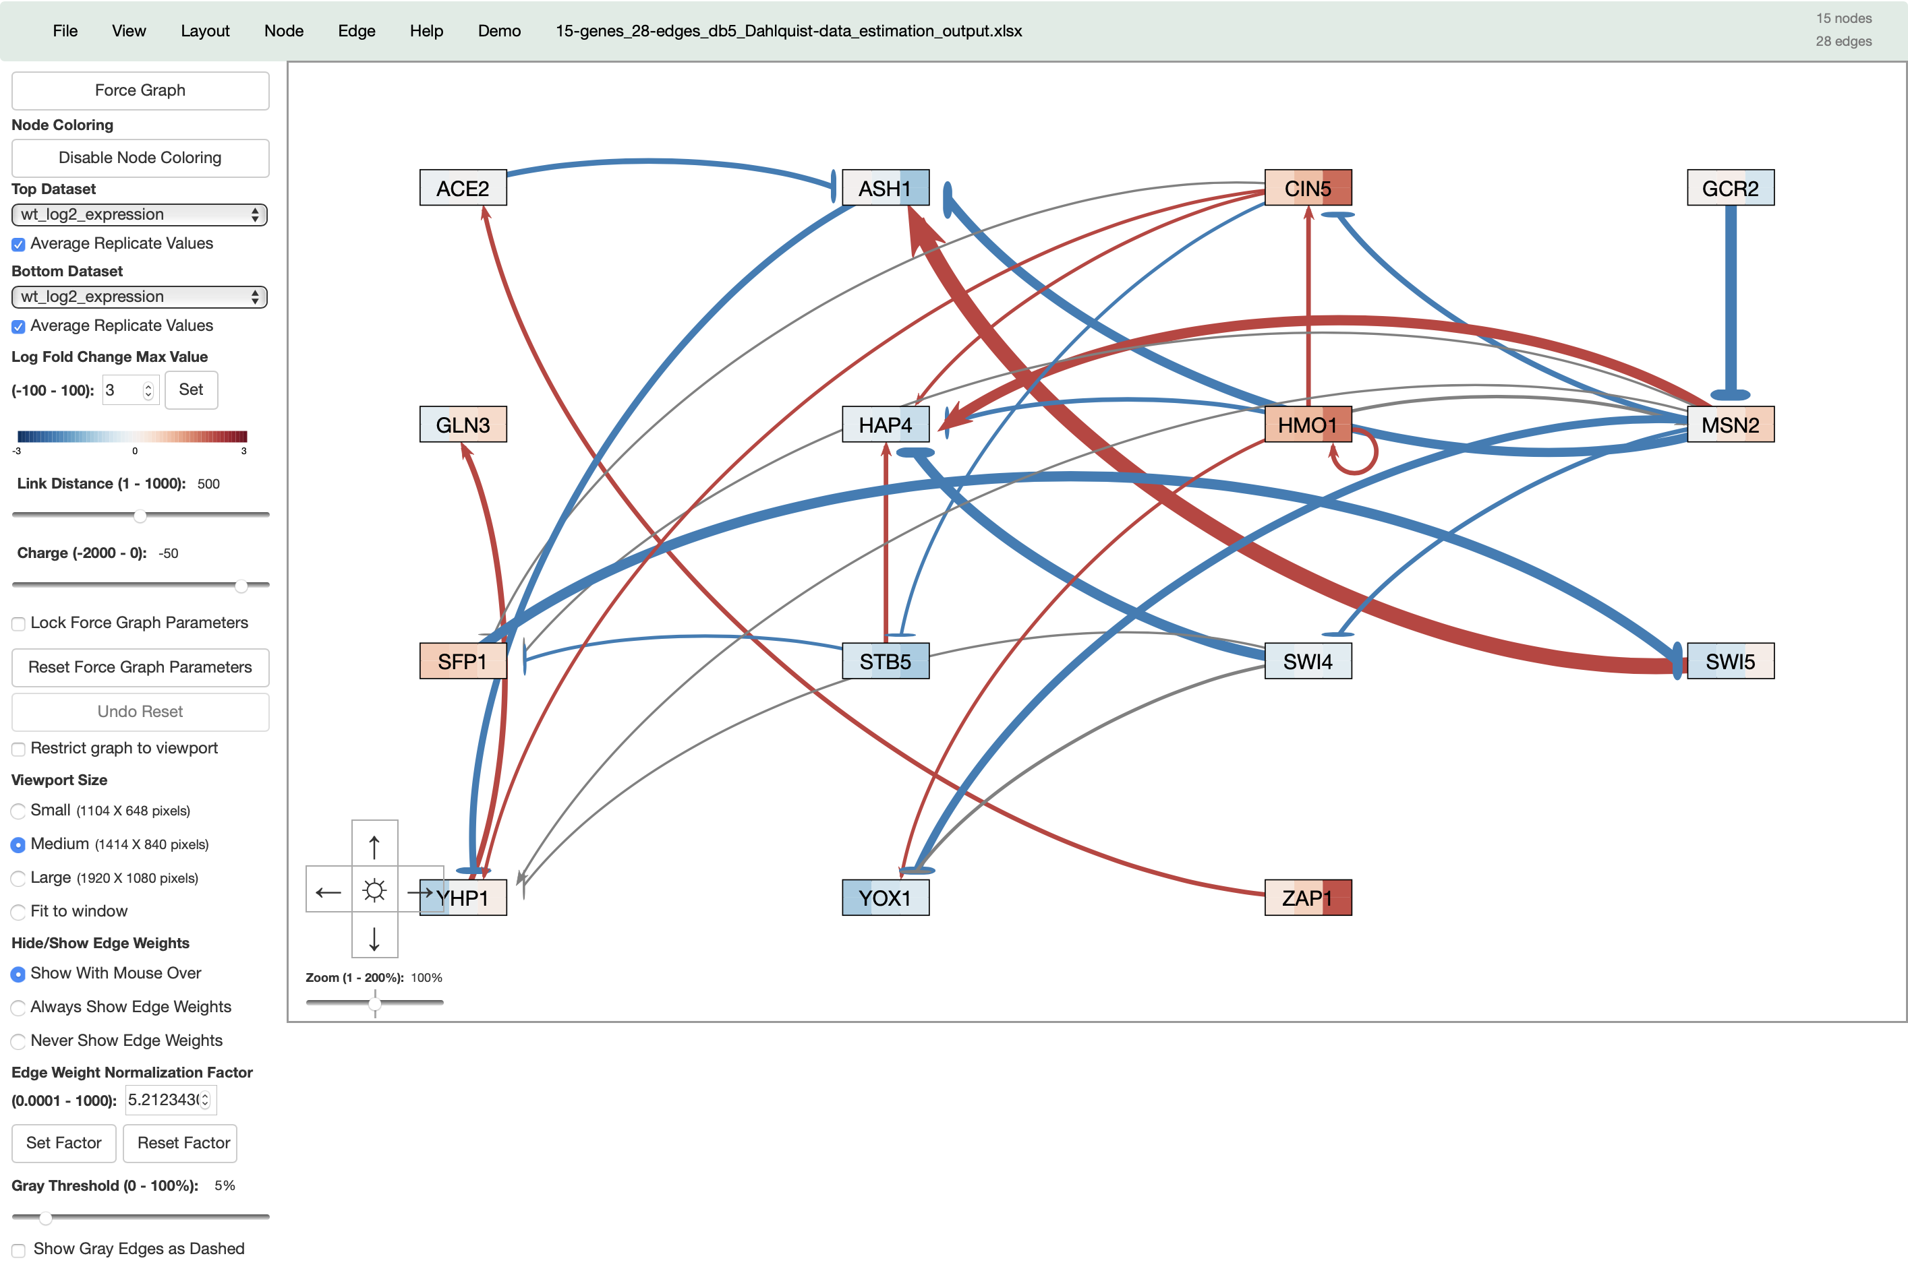


GRNsight’s versions have evolved to allow for more functionality since version 1
Key:
gene
activation
repression
weak influence
Screenshot of GRNsight Beta v3.1.12, released February 2019

Slide 16
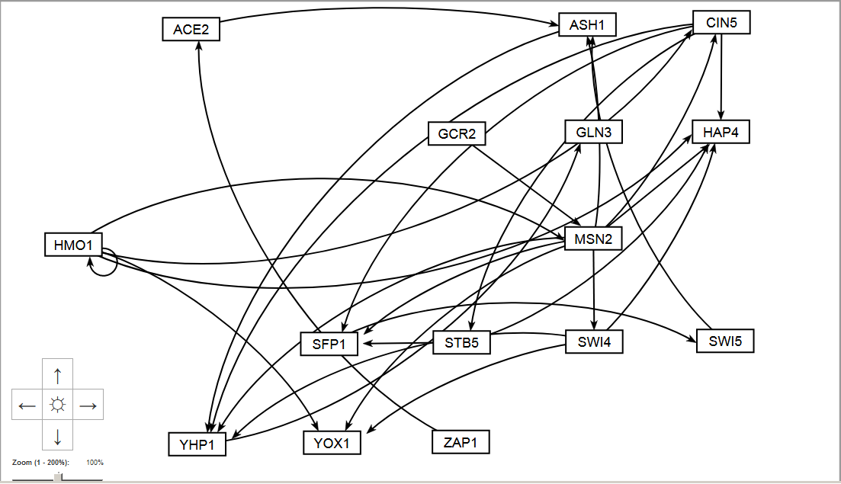
GRNsight now allows users to automatically lay out graphs in an easily readable grid format

Slide 17
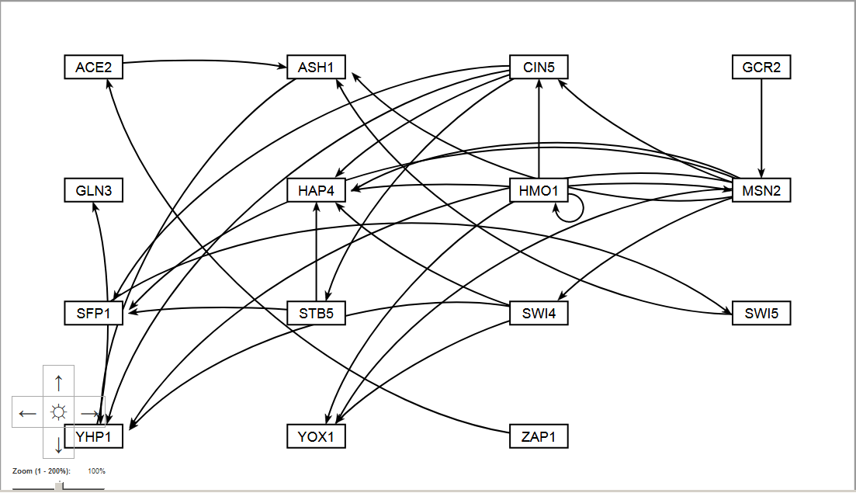
GRNsight now allows users to automatically lay out graphs in an easily readable grid format

Slide 18
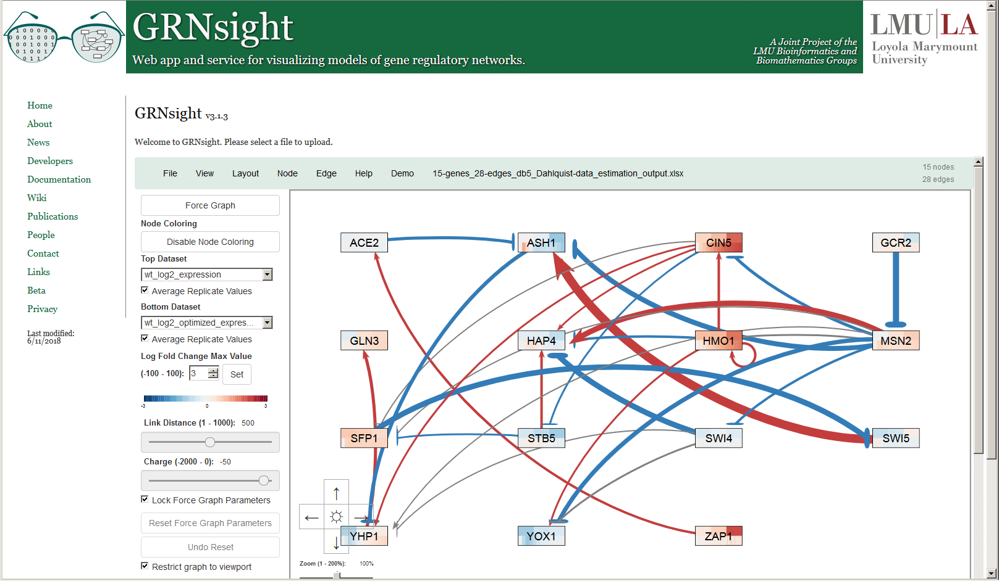
Nodes now display measured and/or simulated expression data as individual heat maps
Top = wild type microarray data
Bottom = wild type model simulated data

Slide 19
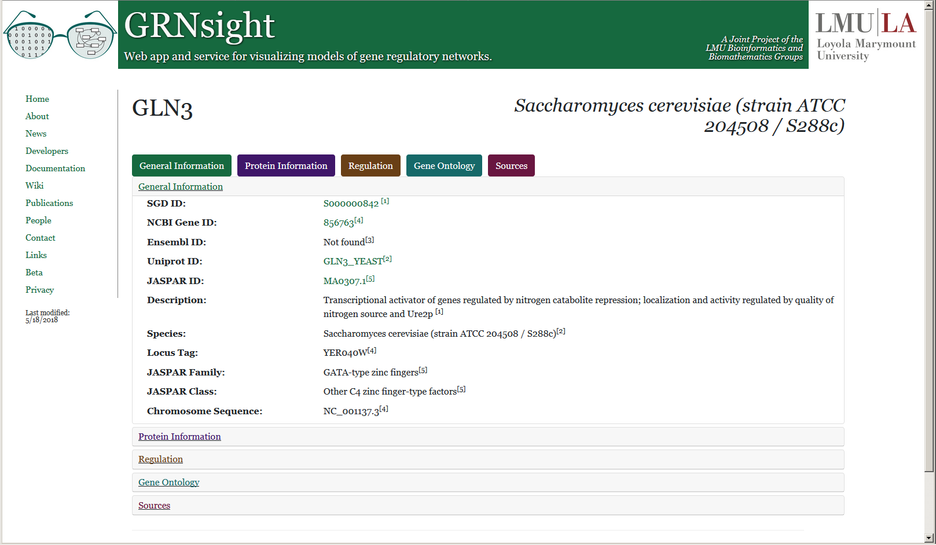
Right-clicking on a node opens a web page which displays information retrieved from various databases

Slide 20
Outline
Gene regulatory networks (GRNs) consist of genes, transcription factors, and the regulatory relationships between them.
GRNsight is an open source web application and service for visualizing models of gene regulatory networks.
GRNsight has evolved significantly since version 1.0, adding useful new features
In GRNsight version 3.0, features were added to better facilitate graph comparison and sharing.
In GRNsight version 3.0, a complete refactor was done on the codebase, transitioning it to a strict Model-View-Controller paradigm.

Slide 21
Outline
Gene regulatory networks (GRNs) consist of genes, transcription factors, and the regulatory relationships between them.
GRNsight is an open source web application and service for visualizing models of gene regulatory networks.
GRNsight has evolved significantly since version 1.0, adding useful new features
In GRNsight version 3.0, features were added to better facilitate graph comparison and sharing.
In GRNsight version 3.0, a complete refactor was done on the codebase, transitioning it to a strict Model-View-Controller paradigm.

Slide 22
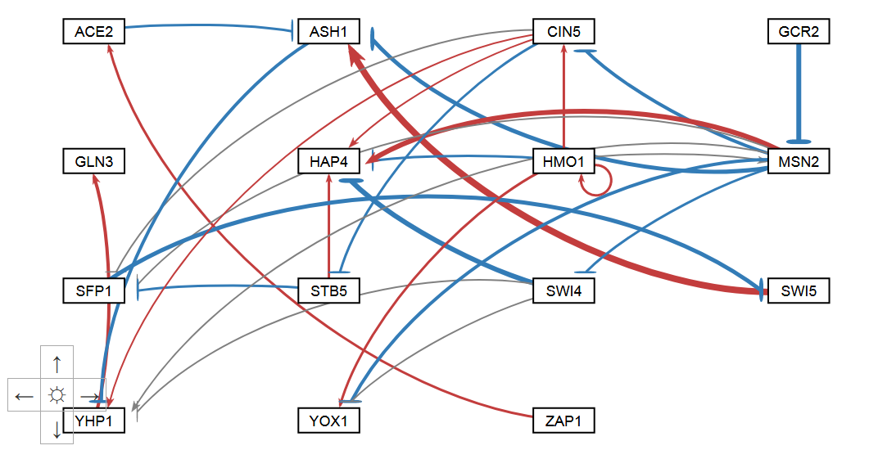
Graph Modulation: Normalization Factor
To facilitate better comparison of graphs, users may now modulate normalization factor
Normalization Factor = 5.21

Slide 23
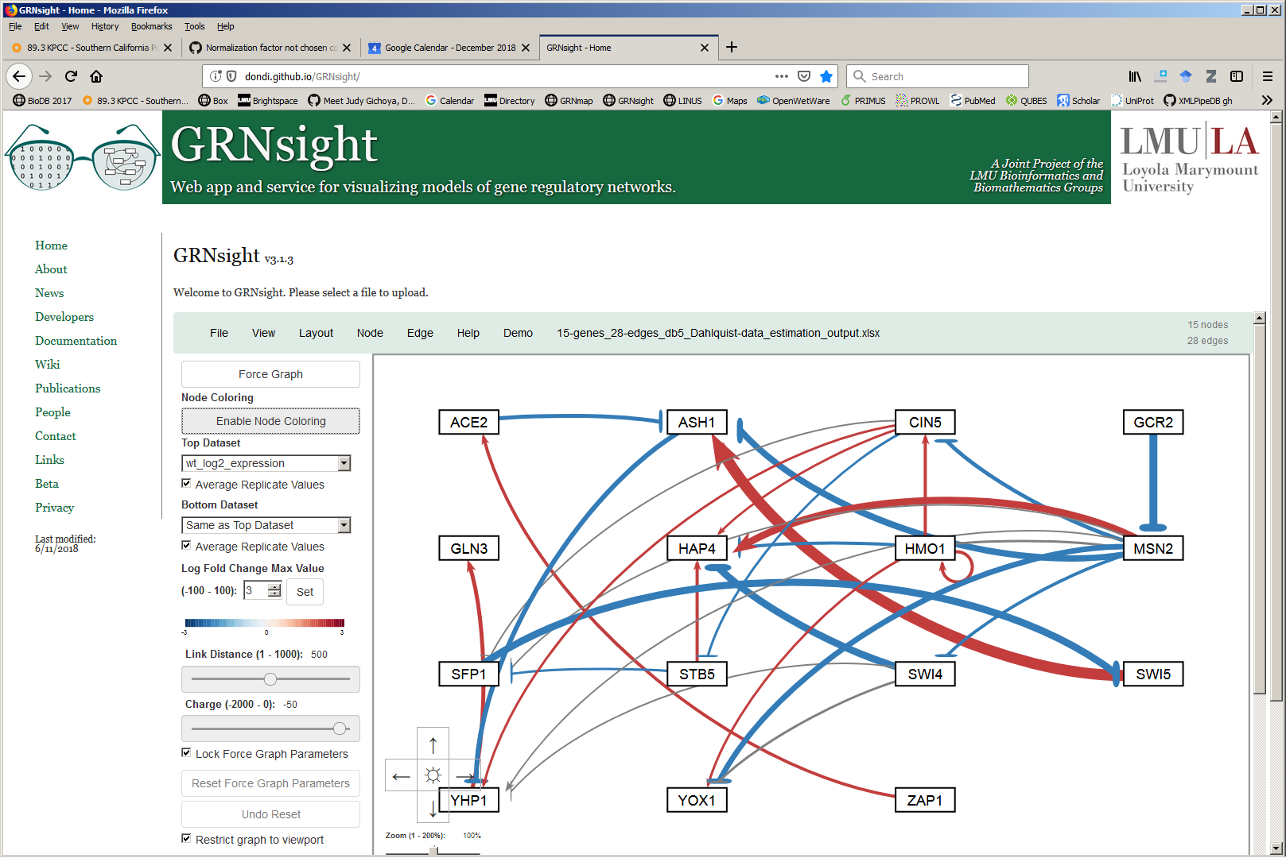
Graph Modulation: Normalization Factor
To facilitate better comparison of graphs, users may now modulate normalization factor
Normalization Factor = 10

Slide 24
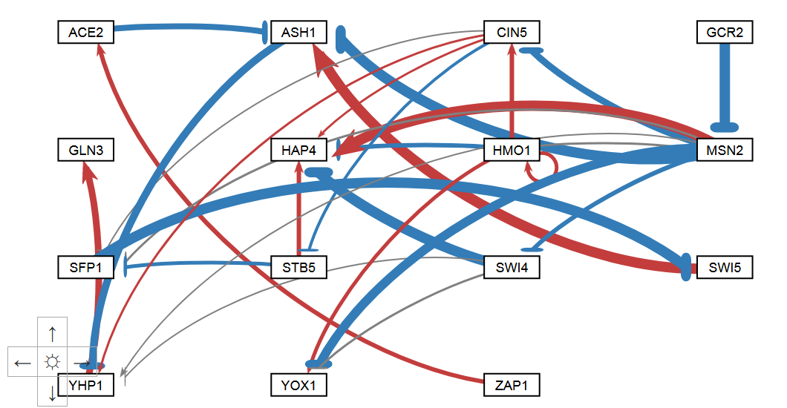
Graph Modulation: Normalization Factor
To facilitate better comparison of graphs, users may now modulate normalization factor
Normalization Factor = 2.5

Slide 25
Graph Modulation: Gray Edge Threshold
To allow users to direct attention to certain nodes, users may now adjust gray edge threshold
Gray Threshold = 5%

Slide 26
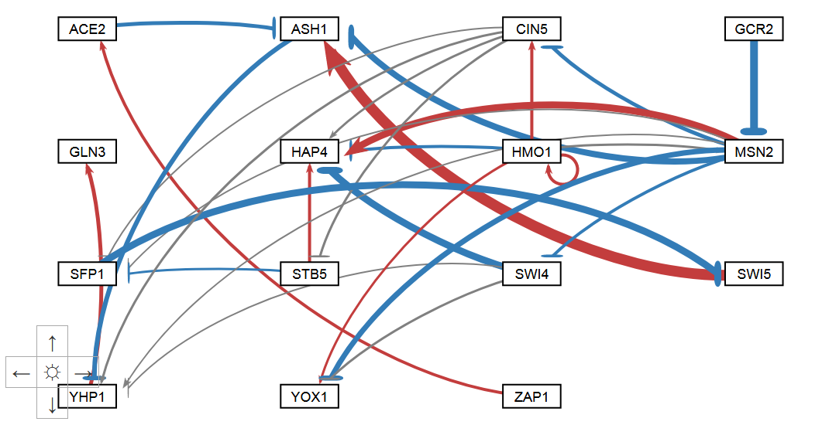
Graph Modulation: Gray Edge Threshold
To allow users to direct attention to certain nodes, users may now adjust gray edge threshold
Gray Threshold = 10%

Slide 27
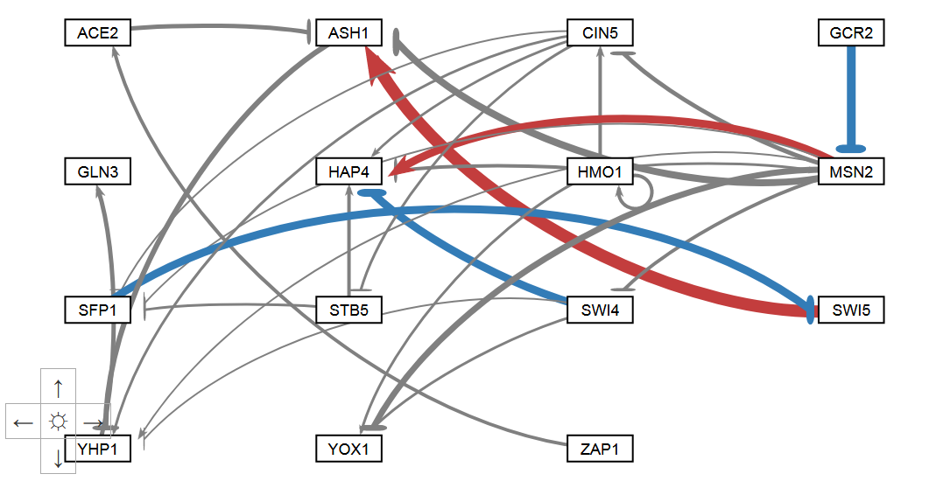
Graph Modulation: Gray Edge Threshold
To allow users to direct attention to certain nodes, users may now adjust gray edge threshold
Gray Threshold = 50%

Slide 28
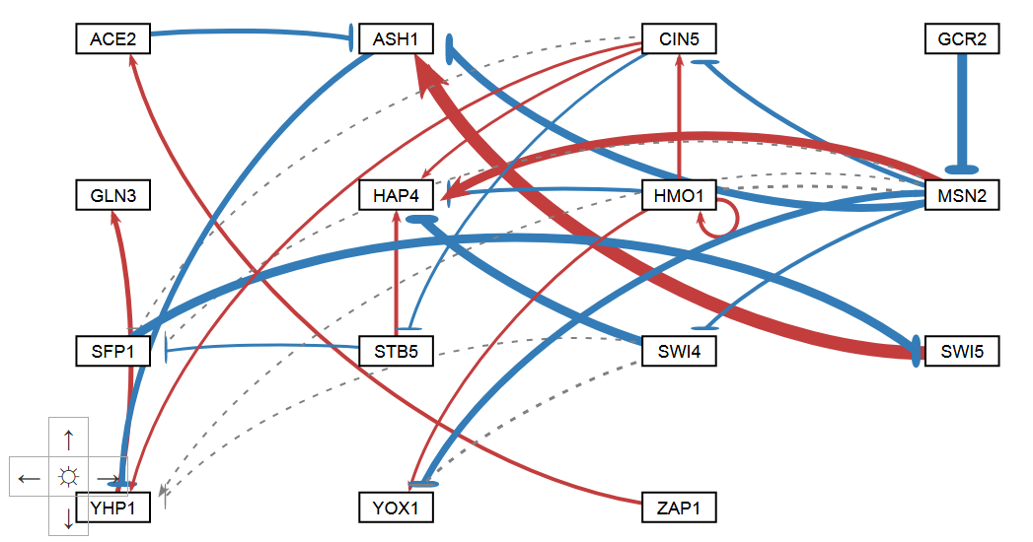
Graph Modulation: Gray Edges as Dashed Lines
As a benefit to visually impaired users, gray edges may be displayed as dashed lines
Gray Threshold = 5%

Slide 29
Outline
Gene regulatory networks (GRNs) consist of genes, transcription factors, and the regulatory relationships between them.
GRNsight is an open source web application and service for visualizing models of gene regulatory networks.
GRNsight has evolved significantly since version 1.0, adding useful new features
In GRNsight version 3.0, features were added to better facilitate graph comparison and sharing.
In GRNsight version 3.0, a complete refactor was done on the codebase, transitioning it to a strict Model-View-Controller paradigm.

Slide 30
Outline
Gene regulatory networks (GRNs) consist of genes, transcription factors, and the regulatory relationships between them.
GRNsight is an open source web application and service for visualizing models of gene regulatory networks.
GRNsight has evolved significantly since version 1.0, adding useful new features
In GRNsight version 3.0, features were added to better facilitate graph comparison and sharing.
In GRNsight version 3.0, a complete refactor was done on the codebase, transitioning it to a strict Model-View-Controller paradigm.

Slide 31
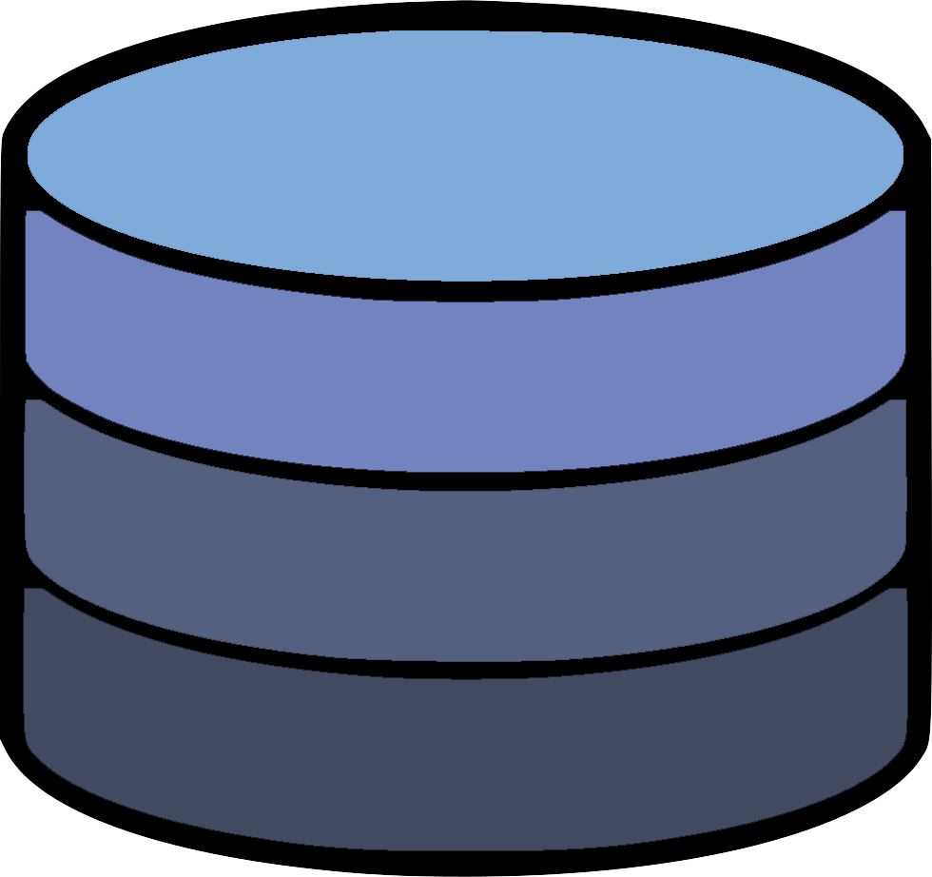
The Model-View-Controller Paradigm
Model
Updates
Manipulates
View
Controller
Sees
Uses
User

Slide 32
GRNsight now follows a strict MVC architecture
grnState
Model
Updates
Manipulates
Update-app
View
Controller
Setup-handlers
Sees
Uses
User

Slide 33
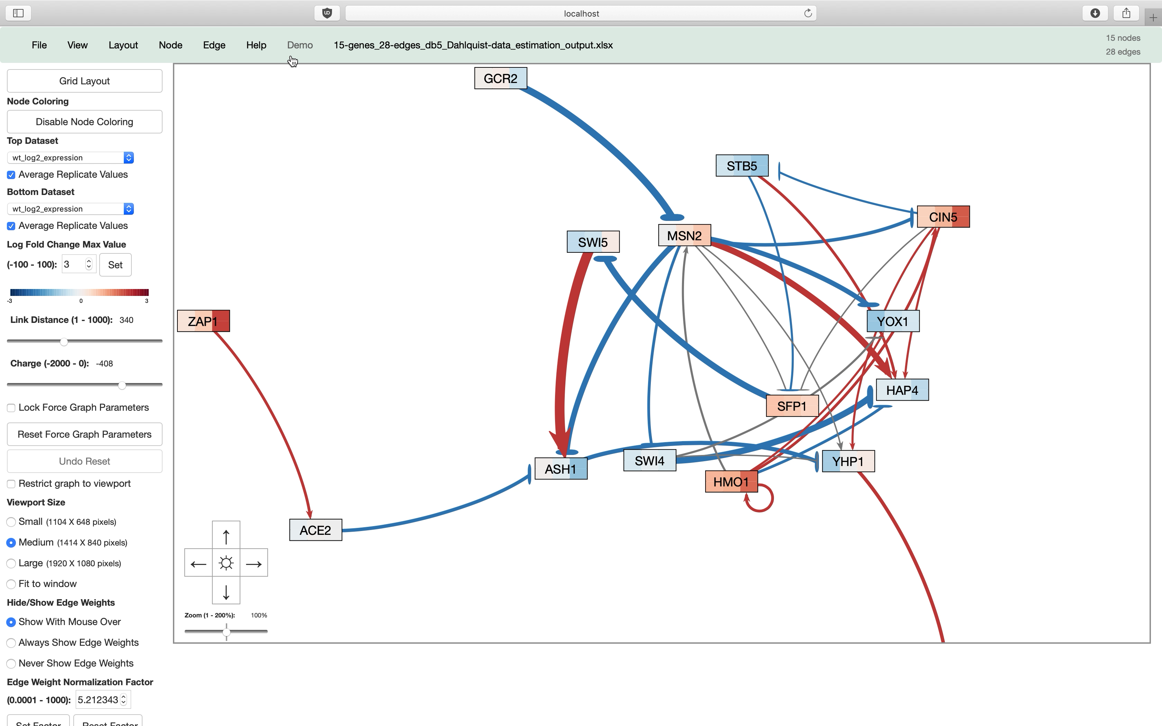
GRNsight now follows a strict MVC architecture (kind of)
Graph Physics
(Not MVC)
User-Inputted Parameters
(MVC)

Slide 34
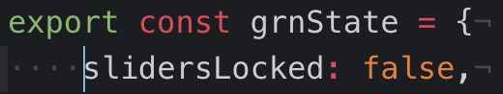
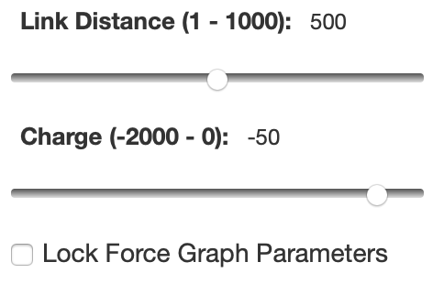
An example of MVC in action
Locking Force Graph Parameter Sliders

Slide 35
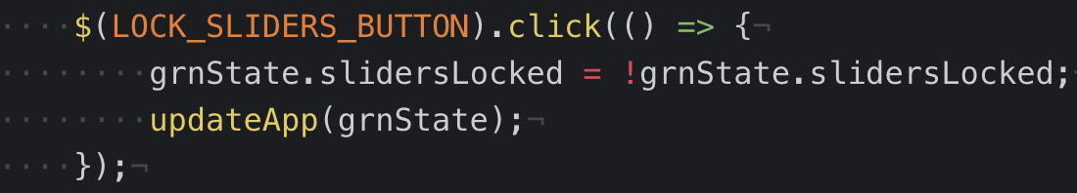
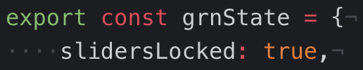
An example of MVC in action
Locking Force Graph Parameter Sliders

Slide 36
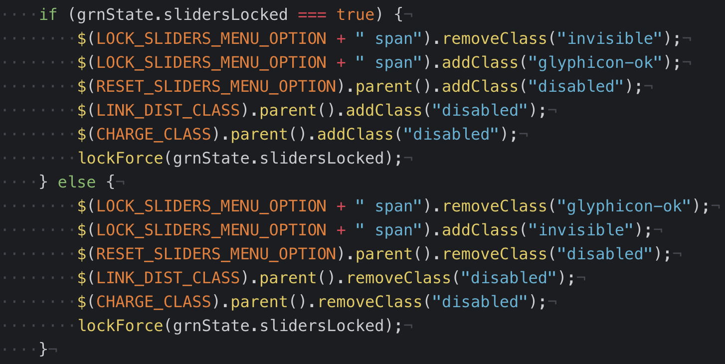
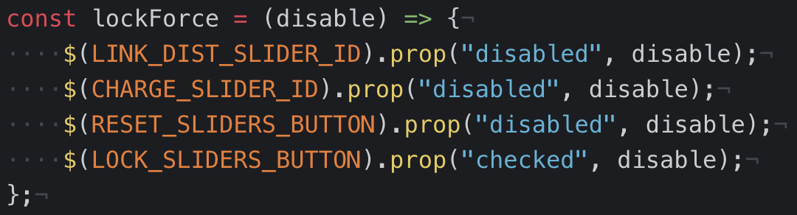
An example of MVC in action
Locking Force Graph Parameter Sliders

Slide 37
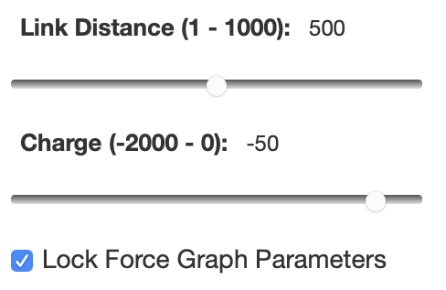
An example of MVC in action
Locking Force Graph Parameter Sliders

Slide 38
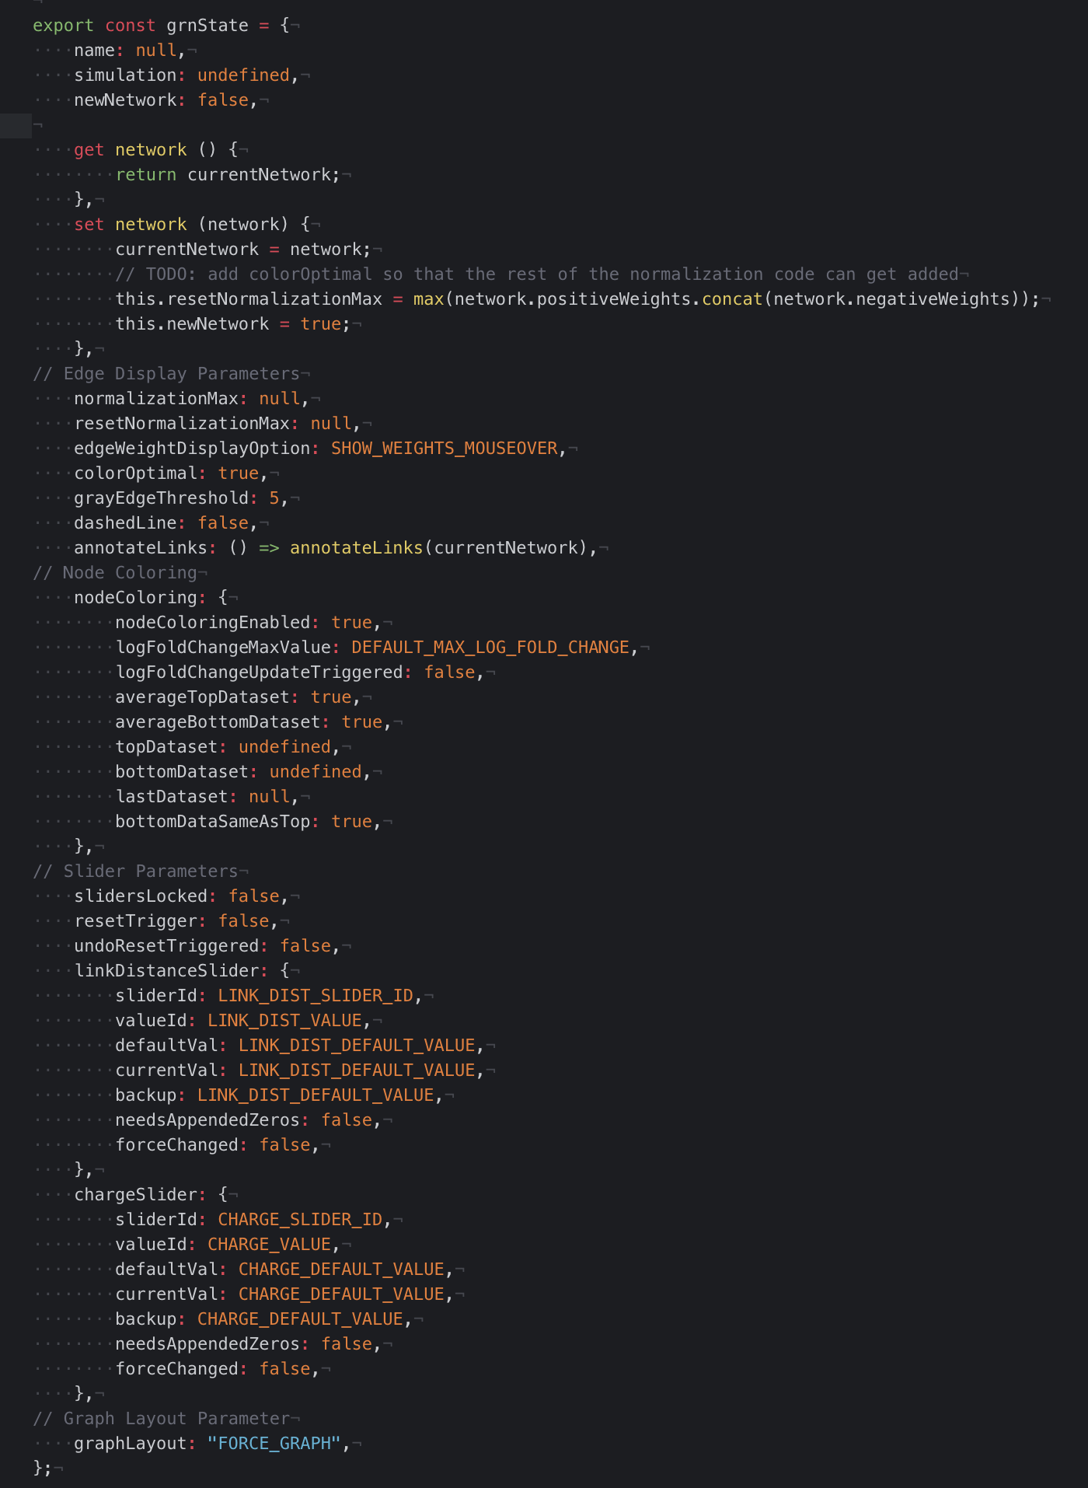
Why the MVC architecture?
Central store for application state & increased modularity:
Lessening application state conflicts
Diagnosing a bug?
Adding a new feature?

Slide 39
Conclusion
Gene regulatory networks (GRNs) consist of genes, transcription factors, and the regulatory relationships between them.
GRNsight is an open source web application and service for visualizing models of gene regulatory networks.
GRNsight has evolved significantly since version 1.0, adding useful new features
In GRNsight version 3.0, features were added to better facilitate graph comparison and sharing.
In GRNsight version 3.0, a complete refactor was done on the codebase, transitioning it to a strict Model-View-Controller paradigm.

Slide 40
GRNsight application and code are available under the open source BSD license
http://dondi.github.io/GRNsight/
https://github.com/dondi/GRNsight
Current and future work documented via Github Issues
Graph.js as an object
ReactJS
Graph Statistics

Slide 41

Acknowledgements
Loyola Marymount University
Dr. Kam D. Dahlquist
Dr. John David N. Dionisio
GRNsight Team
Alexa Filler
John Lopez
GRNmap Team
Justin Kyle Torres
Wet Lab Team
Lauren Kelly
Genesis Cruz

